Slide 1
Evolving Your Property through Technology and Branding

Slide 2
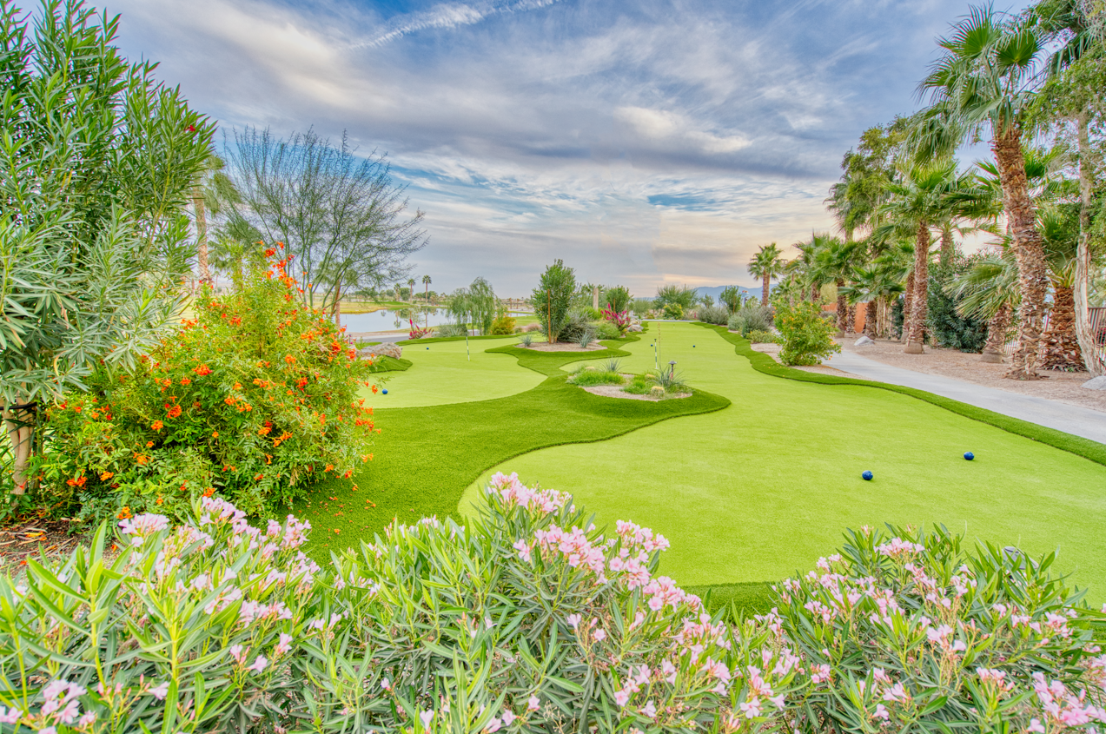
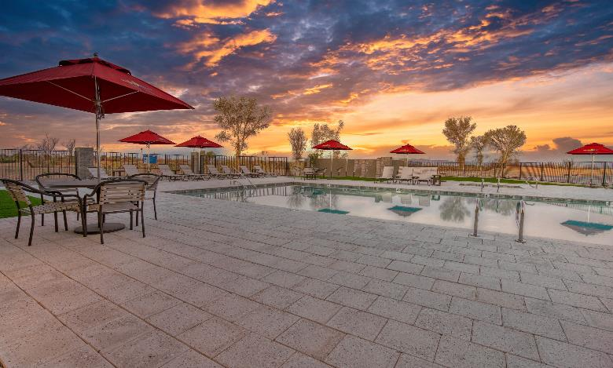
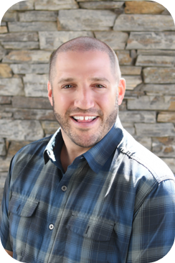
Mike Harrison
Chief Operating Officer
Mike Harrison joined CRR team in 2020 and has 30 years in the hospitality industry. He is a graduate of the University of Massachusetts (Amherst) and the International College of Hospitality Administration in Brig, Switzerland. Mike's tenure with Outdoor Hospitality, Hotels, Hospitality, Operations, and Executive Leadership experience, has included numerous corporate positions with many of the nation's top hospitality companies.
After starting his career with Winegardner & Hammons, Mike had many successful years at Waterford Hotel Group, Sage Hospitality, and CSM Corp prior to joining CRR. He managed portfolios for Marriott, Hilton, and Lifestyle hotels, totaling over $130 million. Mike has served in many other hotel and hospitality related roles such as the Campspot Advisory Board, Expitality Alliance, California Outdoor Hospitality Association, Canadian Outdoor Expo, UMass Advisory Board, and as a Guest Lecturer on Arizona State University's Hospitality Advisory Board.
Notes:
Good morning,
Excited to be here, thanks for having me
I have 30 years in the hospitality business, including with major hotel chains including Marriott and Hilton, which helps understand successful branding. I have worked for lifestyle hotels RV resorts and created a couple restaurant brands.

Slide 3
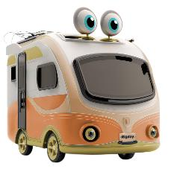
CRR Hospitality
At CRR, we are dedicated to creating memorable vacations and convenient storage solutions that our customers will always remember. We are currently developing RV Resorts, RV storage facilities, MH Neighborhoods, and Car Washes across the US. Our goal is to provide an amazing experience and fulfillment for all those involved – whether they are guests traveling on vacation, residents living in our neighborhoods, or accessing their RV that is stored at one of our properties nationwide.
RV Resorts
Manufactured Housing
Arizona, California, South Carolina
Arizona
RV Storage and Self Storage
Hotels and Other Businesses
Arizona, California, South Carolina
Notes:
We are a hospitality company with background in developing upscale, luxury RV Resorts, RV storage, manufactured neighborhoods, upscale car washes, and hotels.
We have many hospitality businesses and we focus a lot of time on branding consistency.
Why? Consistent branding drives loyalty, word of mouth business, reputation management, which equals REVENUE
We have spent a lot of time on developing our brands with consistent signature differentiators and brand voice. You can see by our logos.
Can apply to small or large parks or companies.
We launched what we believe to be the first AI chat bot in the industry, named Rigsby. He is unique and trademarked.

Slide 4
What is “Technology”?
Systems
Platforms
Processes
Efficiencies
Notes:
“Evolve the Industry to the Modern World”
Rigsby
Digital, modern marketing, updating website and social presence, pics, GMB, understanding today’s SEO
Campspot Analytics, leveraging your PMS and integrations.
Revenue Management
Profitsword
Maintenance Care
Sage Intuit
Vuity
Access Parks (best in class wifi)
Smart Cabins
Api’s
Texting
GuestRevu
Separates you

Slide 5
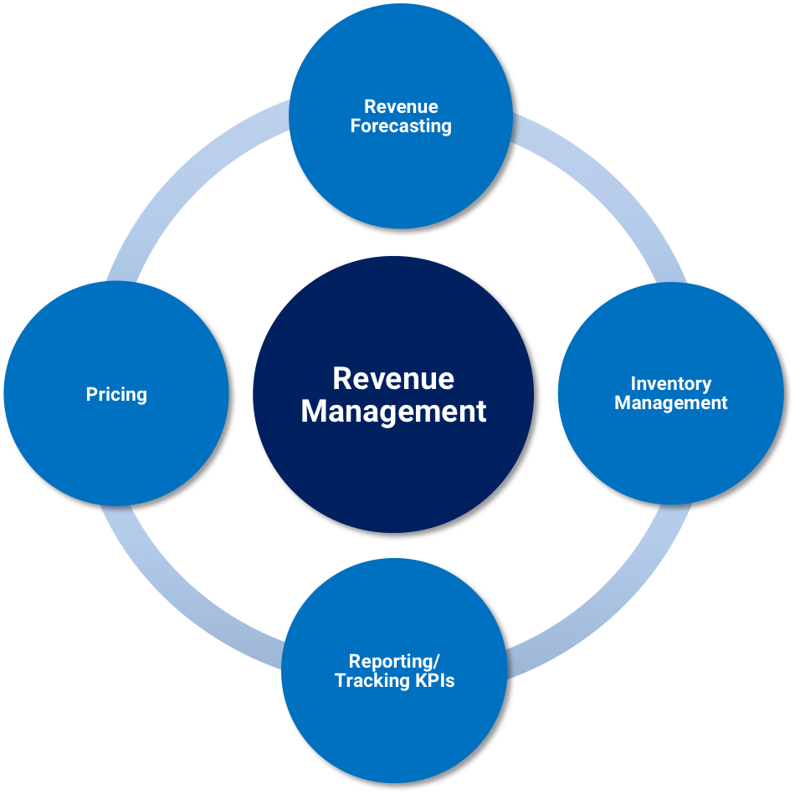
What is “Technology”?
Systems
Platforms
Processes
Efficiencies
Notes:
“Evolve the Industry to the Modern World”
Rigsby
Digital, modern marketing, updating website and social presence, pics, GMB, understanding today’s SEO
Campspot Analytics, leveraging your PMS and integrations.
Revenue Management
Profitsword
Maintenance Care
Sage Intuit
Api’s
Texting
GuestRevu
Separates you

Slide 6
What is a Brand?
A brand is a name, term, design, symbol or any other feature that distinguishes one seller's good or service from those of other seller
A brand is promise, an experience
A brand builds loyalty
A brand evokes emotion
Notes:
Who has an Iphone? Who has an Iphone 12 or older. If I gave you my brand new Pixel 8, hot out of the box, for free intrade would you take it?
Why not? Has the best new camera, has new AI photo editing
When you see Strabucks, what does that mean to you? How does it make you feel? Starbucks vs Dunkin?
Is Nike selling shoes, or lifestyle?
A brand evokes emotion

Slide 7
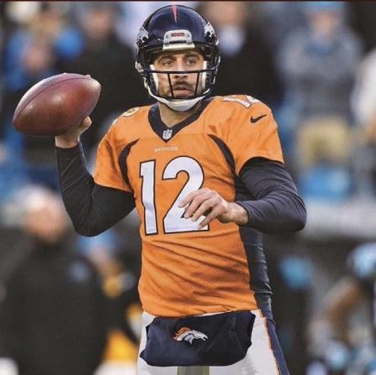
DNA / Vibe
What is it?
Should never waiver from what it is defined as
Think of some popular brands and what they mean to you
Should be pervasive throughout the property and all associates know it
Must be consistent and intentional, not piecemeal
What is your DNA to create and drive your brand identity?
What happens when it's wrong?
Notes:
Tell the story about Fire + Spice.
How we created it
5 words to describe it
Sizzle, southwest, energy, communal, fire

Slide 8
Who is responsible for branding?
Everyone!
What does branding apply to?
Everything!
Notes:
Is this just for the marketing dept?
If the brand or logo is created but then the property doesn't deliver then it falls flat. Must be consistent, and not created and forgotten.
Branding applies to everything

Slide 9
What should be consistent when using your brand?
Everything!
Fonts, colors, proportions should all be consistent. i.e. websites
Why?
"Everything communicates"
Notes:
Logo consistency, color consistency, font consistency. MUST have integrity. I.e. wouldn’t put yellow in the KC Chiefs logo.
Do all of you associates have proper uniform? Is it the same?
You can go into any starbucks and know exactly white a white chocolate mocha is, what size, the flavor, same cup, etc... And they write your name on the cup. If they served it in a brown cardboard cup with no logo or name on it, you arent confident in what you are getting.
Call attention to my outfit – what am I saying when I wear this? Now Put on hat, glasses, take shirt off. Now what does this say?
What are your property, associates, logo, website communicating?

Slide 10
Where do you use your brand?
Everywhere!
Physical
Uniforms
Signage
Buildings
Equipment
Digital
Website
Social media
Email campaigns
PMS
Print
Advertising
Signs
Maps
Packaging

Slide 11
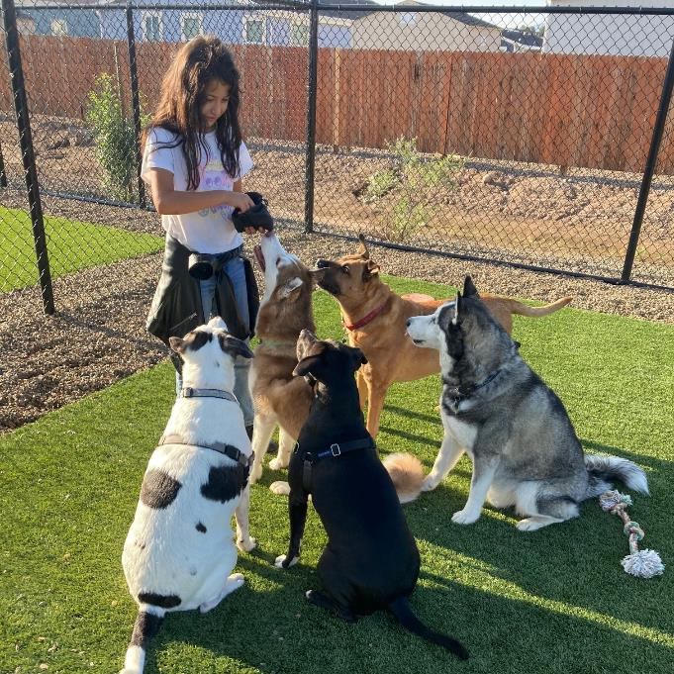
Storytelling and Activating

Slide 12
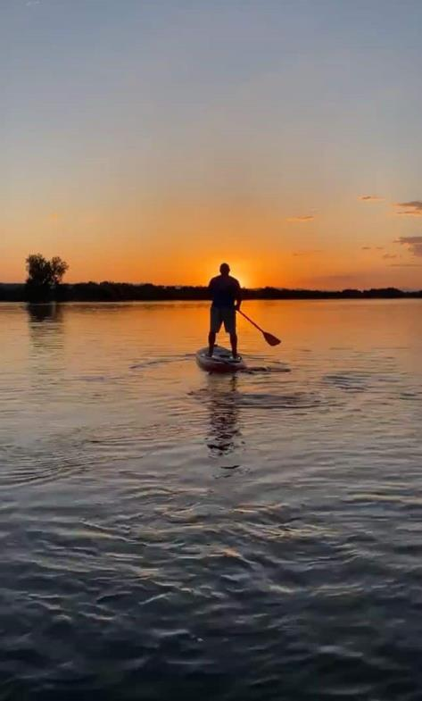
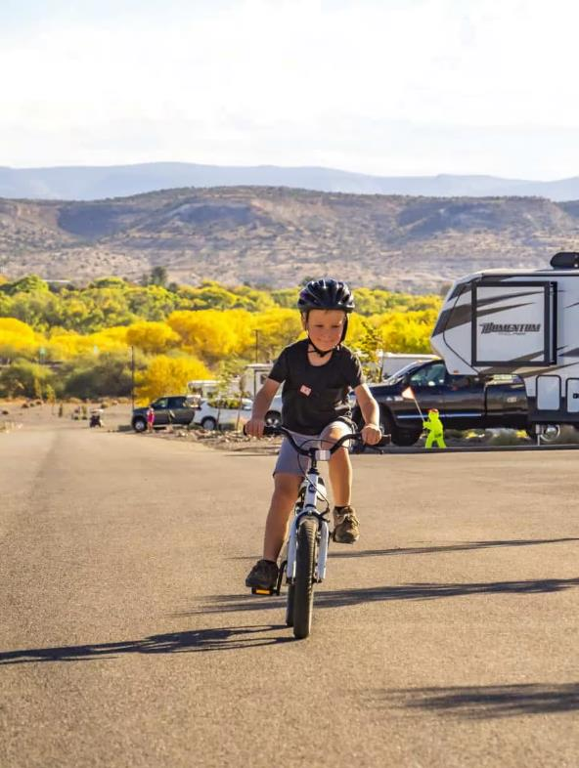
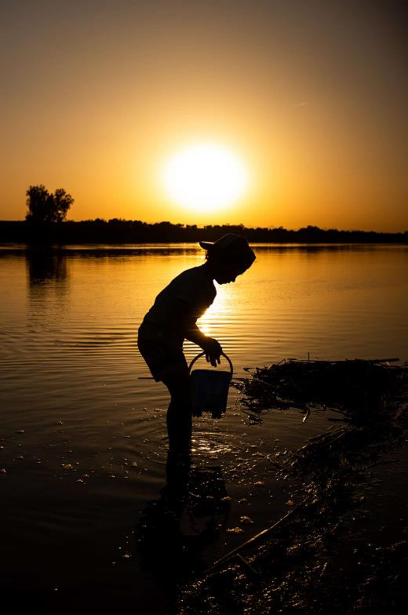

Slide 13
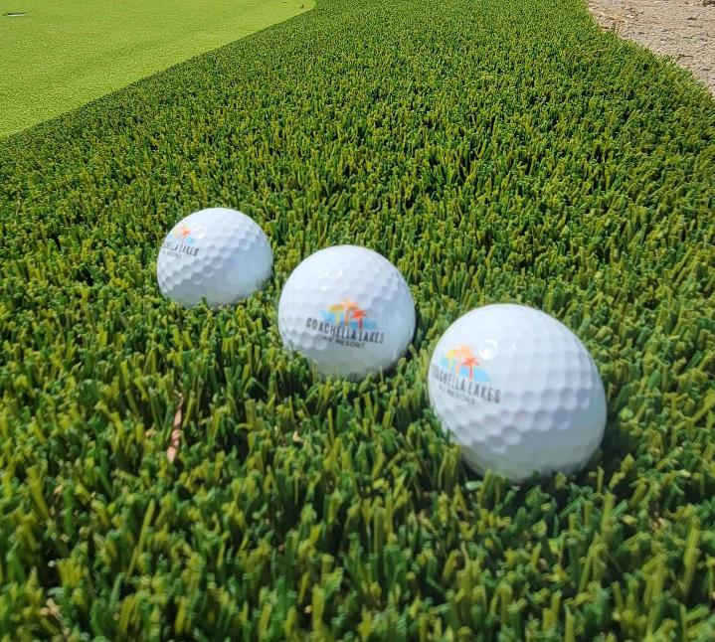
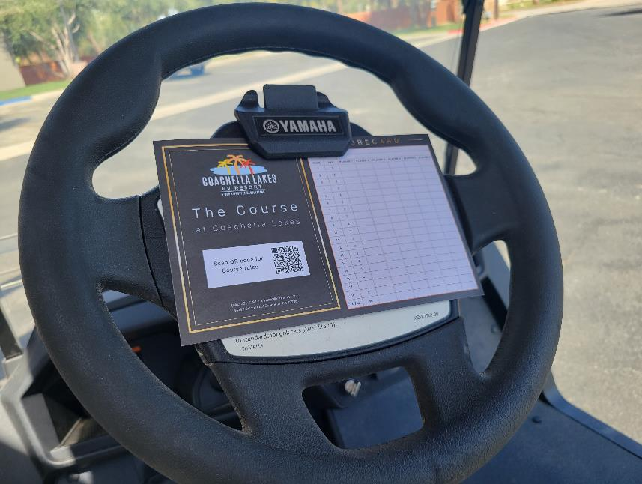

Slide 14
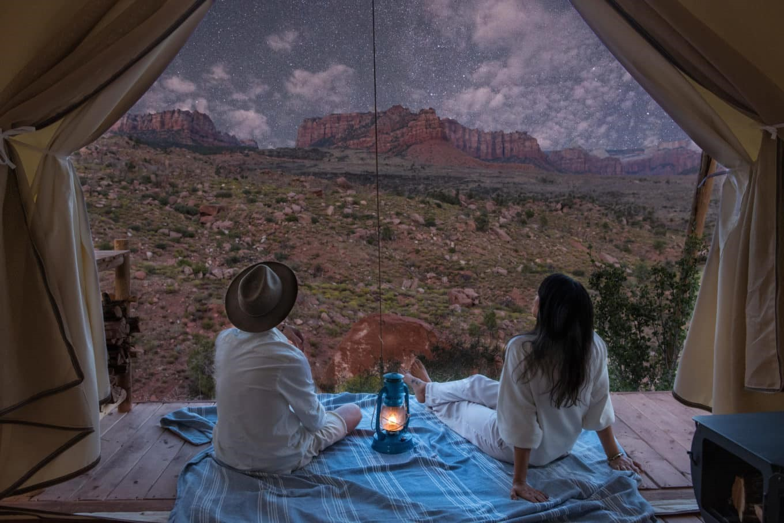

Slide 15
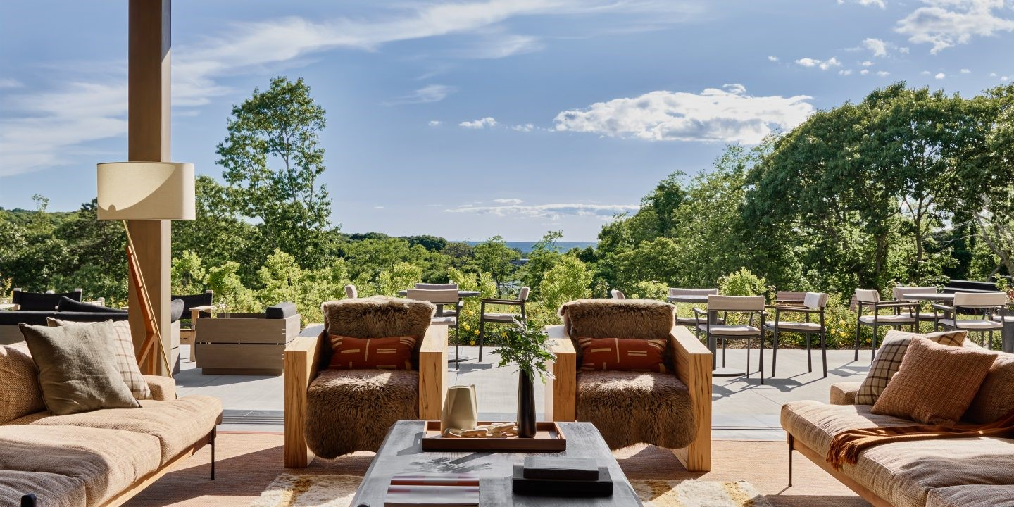

Slide 16
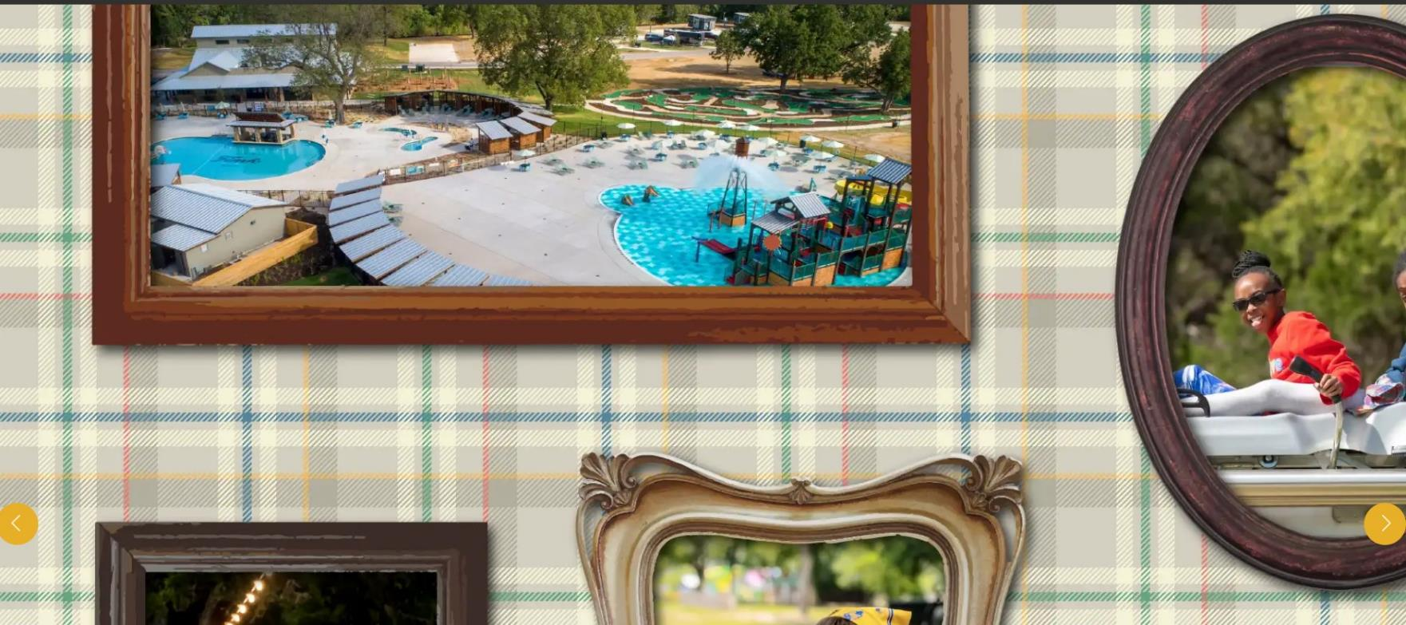

Slide 17
Questions?
Connect with me:
mharrison@crrhospitality.com
Linked In
www.crrhospitality.com

Slide 18
THANK
YOU

