Slide 1
Great Management Skills!

Slide 2
Mike Harrison, Chief Operating Officer CRR Hospitality
Mike Harrison joined the CRR team in September 2020. He has 30 years in the hospitality industry. He is a graduate of the University of Massachusetts (Amherst) and the International College of Hospitality Administration in Brig, Switzerland. Mike's tenure with Hotels, Hospitality, Operations, and Executive Leadership experience, has included numerous corporate positions with many of the nation's top hospitality companies.
After starting his career with Winegardner & Hammons, Mike had many successful years at Waterford Hotel Group, Sage Hospitality, and CSM Corp. He managed portfolios for Marriott, Hilton, and Lifestyle hotels, totaling over $130 million. Mike has served in many other hotel and hospitality related roles such as the Townplace Suites Booster Committee, UMass Advisory Board, and as a Guest Lecturer on Arizona State University's Hospitality Advisory Board.

Slide 3
CRR Hospitality
At CRR, we are dedicated to creating memorable vacations and convenient storage solutions that our customers will always remember. We are currently developing RV Resorts and RV storage facilities across the US as well as providing management services for Glamping Resorts, RV Resorts, Campgrounds and more! Our goal is to provide an amazing experience and fulfillment for all those involved – whether they are guests traveling on vacation, residents living in our neighborhoods, or accessing their RV that is stored at one of our properties nationwide.
RV Resorts
Manufactured Housing
Arizona, California, South Carolina
Arizona
RV Storage
Hotels and Other Businesses
Arizona, California, South Carolina

Slide 4
Strategic
Management Skills
Communication
Decision Making
Delegation
Problem Solving
Motivating
Revenue Generation
“The most important thing in communication is to hear what isn’t being said”
-Peter Drucker
Financial Acumen
Notes:
There are many, many competencies that are important to focus on when speaking about management skills. Could argue some are more important than others, this list is not all encompassing.
I.e. of course you need to have financial acumen and the ability to drive successful and profitable business results. But that is kind of the barrier to entry and should be a given. It's like stating that a cashier must have good cash handling skills. Today we will focus on some of the other soft skills and competencies that help separate great leaders from just good leaders.

Slide 5
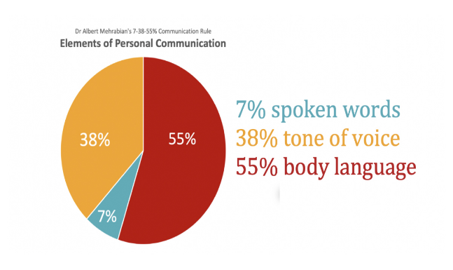
Communication
Verbal Non-Verbal Visual Written
Good communication is an essential tool in achieving productivity and maintaining strong working relationships at all levels of an organization.
Associate Engagement Survey
Daily Huddles, Meetings
Conduct annual or semi-annual surveys
Discuss arrivals, special needs, meetings, wins…
Checklist / Pass On Log, other tools
Performance Evaluations, Feedback
Each department completes daily checklists. Use log to keep all departments updated
Conduct annual evaluations, offer detailed specific feedback, complete self-reviews
Notes:
What kinds of communication are there?
Why is it important to recognize each one? Have done over 75 associate opinion surveys and in 90% of them, communication is always lowest scoring category.
Only 7% of communication is verbal
Need to be effective at all kinds – which do you use the most? Be aware, and be aware how you come across, ask for feedback.
Need all associates aligned

Slide 6
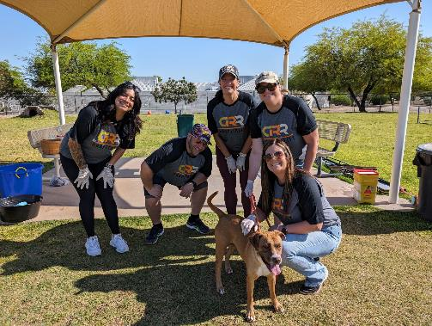
Building
Teams
Through
Communication
1.
2.
Forming
Storming
When a new team forms team members will be unsure of the team purpose, how they fit in, and whether they’ll work well with one another. They may be anxious, curious, or excited to get started. They will be looking for their supervisor/manager for direction
Team members start to push against the established boundaries. Conflict or friction can also arise between team members as their true characters and preferred ways of working surface.
3.
3.
4.
Norming
Performing
Gradually, the teams moves into norming stage. Team members start to resolve their differences, appreciate each others' strengths, and respect the authority of their leader.
The team is flowing and performing to its full potential. With hard work and structured processes, the team achieves its goals efficiently.
Notes:
Understand where you are in stages of team development.
Can search for forming/storming/norming/Performing online, or can reach out directly to me and I can give you more info. Conduct the exercise with your team

Slide 7
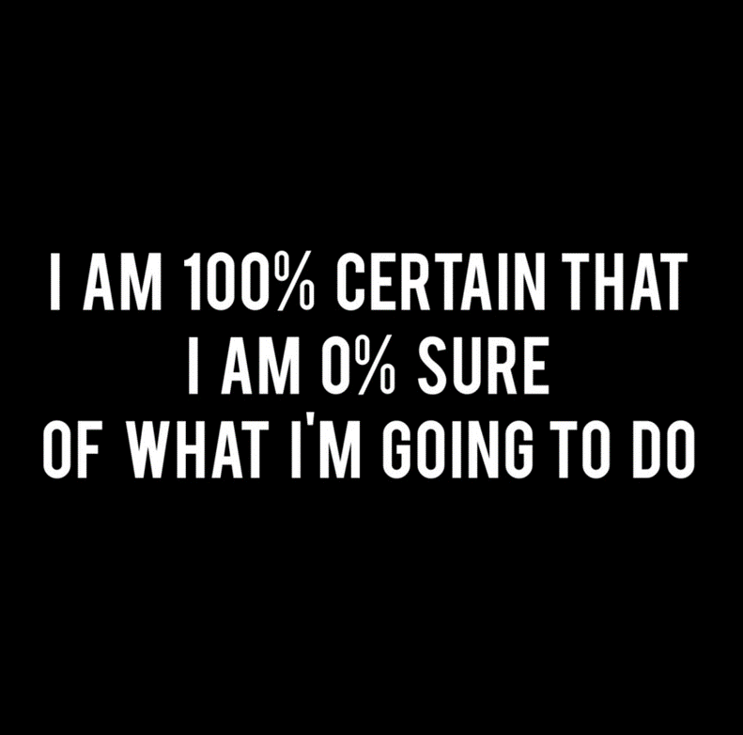
Decision Making
When faced with a tough decision it’s common to feel:
overwhelmed
stressed or anxious
pressured
confused
distracted
tired
unsure
Notes:
Decision making is tough. Sometimes we have tendency to delay a tough decision, put it off, ask someone else, etc...

Slide 8
Two Types of Decision Making
A manager must rely on their reasoning, intuition, experience, and common sense in order to arrive at a decision quickly and effectively.
Don’t let stress get the better of you
Give yourself some time
Weigh the Pros and Cons
Use data
Think about your goals and values
Consider all the possibilities
Finalize your decision
Prepare for role out
Split Second
Strategic
Notes:
How is your judgement? Your boss/owner/associate wants to have confidence and trust in you to make good decisions. How do you do that? How do you communicate it.
Have confidence, use experience, be consistent, rely on your values and intuition, and data.
Sometimes making a bad decision is better than making no decision at all, provides learning opportunities and coaching.

Slide 9
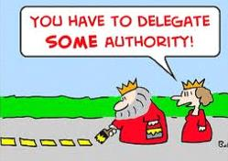
Delegation
Why is delegation so hard?
Pride
Start small
Define how you measure success
Develop a priority system for tasks
Delegate based on skills
Provide clear instructions
Take time to teach
Show trust
Encourage feedback
Balance the delegation
Explain why it matters
Believing that we are the only ones who can accomplish the task. No one can do it better than I can.
Guilt
We don’t want to impose. Feeling that we shouldn’t dump work on someone else. So instead, we do it ourselves.
Trust
This requires accepting that failure is a possibility.
Notes:
Delegation is one of the hardest skills to learn, and one of the most important.
Why do we delegate? It frees up time for us, and helps develop our team at the same time. You don’t always have to be the decision maker, makes the overall business stronger.
Steps of delegation
Why is it so hard?
Do you have to be the one to code invoices every week, or can you train someone else? If you are spending 2 hours/week X 50 weeks = 100 saved hours or two whole weeks of time back

Slide 10
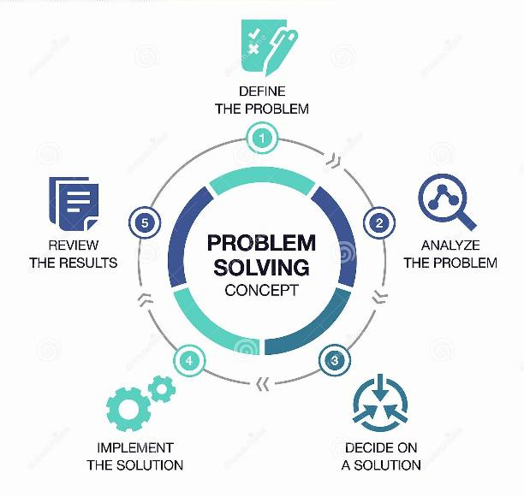
Problem Solving
Leaders with creative problem-solving skills have the ability to stimulate, challenge, and inspire others to continually seek creative solutions for future growth and success.

Slide 11
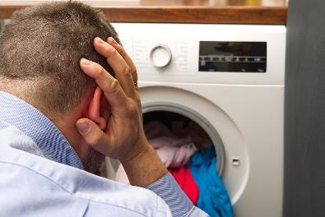
Let’s Get to the Bottom of this Problem…
The 5 Why’s
The resort is receiving frequent complaints about the Laundry Facility
Why?
Why?
Why?
Why?
Why?

Slide 12
Why? The dryers are not efficient
Why? The lint vents haven’t been cleaned
Why? We don’t know which department is responsible
Why? There is not communication between Housekeeping and Maintenance
Why? Department meetings are not being held
Do you see how asking one or two whys is not enough to get to the root of the problem? Do you see how knowing that there is not communication between the departments effects many areas of the resort as well as the guests and team members?
Notes:
5 why's of Washington monument. Don’t just settle for an answer or assume you know. Involve others in the hunt for the answer.
Be curious

Slide 13
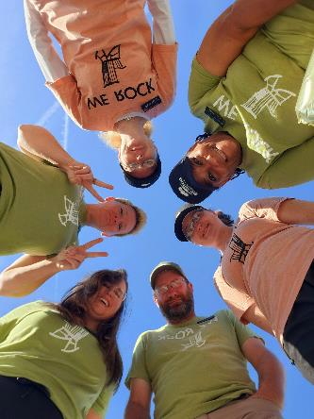
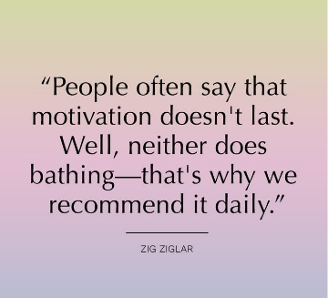
Motivation
Find out what motivates employees
Respect that employees need a work-life balance
Create a sense of staff involvement
Communicate the company’s vision and goals
Give praise as appropriate
Is every associate motivated the same way?
Notes:
Most important thing is to do it, schedule yourself a reminder in outlook. Remember everyone is different – do some general things, and some individual things.
Managers should undertake regular employee satisfaction audits to determine employees’ views. Generally, some of the things that motivate staff include autonomy, recognition, opportunities for achievement, career advancement, participation, and having interesting and worthwhile work.
A formal suggestion scheme should be implemented to encourage and reward staff who suggest ways to improve work methods and operations. It is important employees feel that their views are valued and recognized by management and that they are making a worthwhile contribution to the company’s success.
Employees have interests and responsibilities outside of work. As a manager, it is important to help staff achieve a healthy work-life balance to help them avoid situations where they become unduly stressed or burnout.
Managers should communicate the importance the work employees do for the organization. Employees’ motivation will be increased if they perceive their work as making a significant contribution to the objectives of the organization.
Goals should be specific, realistic, measurable, and challenging.
Recognize when employees have done well and thank them for their work. Give credit as soon as possible, after the event deserving praise, for immediate impact. When showing appreciation, you should specifically describe the desired behavior, state why the desired behavior was helpful and express sincere thanks.

Slide 14
Revenue Generation
Be the Revenue Management Champion
Lead Sales Efforts
3.
Understand all of your Marketing Initiatives
Drive Reputation Management

Slide 15
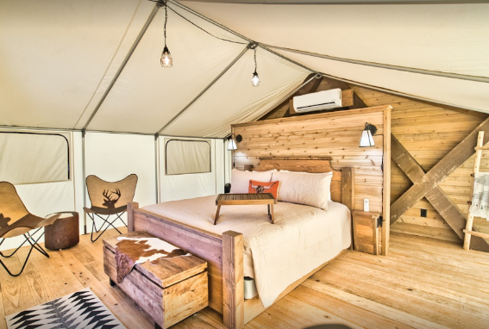
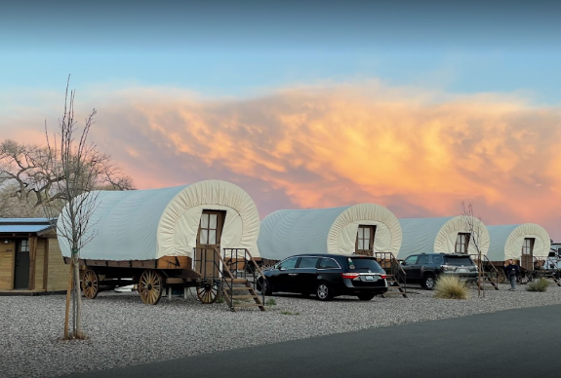
Financial Acumen
Understand your P&L
Be an Expert at Forecasting
Be Curious

Slide 16
What’s Next?
Get ORGANIZED and PRIORITIZE
Immerse YOURSELF
Get involved
Stream a Podcast
Read an article or take a class (start with LinkedIn)
Lead an initiative
Read a book
Good To Great
Monday Morning Leadership
The Heart Lead Leader
By Jim Collins
By David Cottrell
By Tommy Spaulding
Who Moved my Cheese
FYI for your Improvement
Find Your Why
By Spencer Johnson
By Robert W Eichinger
By Simon Sinek

Slide 17
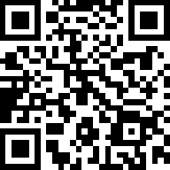
Questions? Connect with me: mharrison@crrhospitality.com Linked In www.CRRHospitality.com

Slide 18
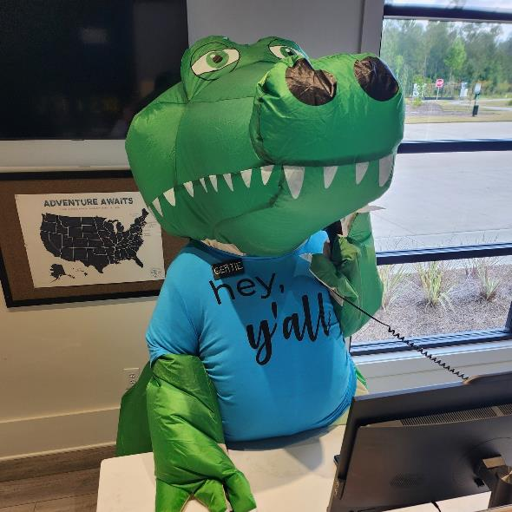
Thank you!

