Slide 1
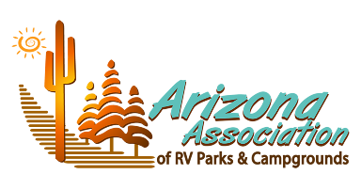
Marketing & Branding for RV Resorts & Glamping

Slide 2
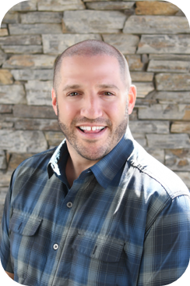
Mike Harrison, Chief Operating Officer CRR Hospitality
Mike Harrison joined the CRR team in September 2020. He has 30 years in the hospitality industry. He is a graduate of the University of Massachusetts (Amherst) and the International College of Hospitality Administration in Brig, Switzerland. Mike's tenure with Hotels, Hospitality, Operations, and Executive Leadership experience, has included numerous corporate positions with many of the nation's top hospitality companies.
After starting his career with Winegardner & Hammons, Mike had many successful years at Waterford Hotel Group, Sage Hospitality, and CSM Corp. He managed portfolios for Marriott, Hilton, and Lifestyle hotels, totaling over $130 million. Mike has served in many other hotel and hospitality related roles such as the Townplace Suites Booster Committee, UMass Advisory Board, and as a Guest Lecturer on Arizona State University's Hospitality Advisory Board.
Notes:
Good morning,
Excited to be here.
Won't spend much time on my background, but I have 30 years in the hospitality business, including with major hotel chains including Marriott and Hilton, which helps understand successful branding

Slide 3
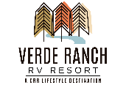
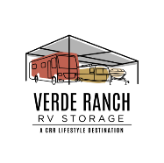
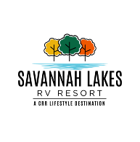
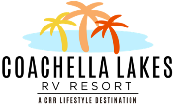
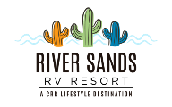
CRR Hospitality
At CRR, we are dedicated to creating memorable vacations and convenient storage solutions that our customers will always remember. We are currently developing RV Resorts and RV storage facilities across the US as well as providing management services for Glamping Resorts, RV Resorts, Campgrounds and more! Our goal is to provide an amazing experience and fulfillment for all those involved – whether they are guests traveling on vacation, residents living in our neighborhoods, or accessing their RV that is stored at one of our properties nationwide.
RV Resorts
Manufactured Housing
Arizona, California, South Carolina
Arizona
RV Storage
Hotels and Other Businesses
Arizona, California, South Carolina
Notes:
We are a hospitality company with background in developing upscale, luxury RV Resorts, RV storage, manufactured neighborhoods, upscale car washes, and hotels.
We have many hospitality businesses and we focus a lot of time on branding consistency.
Why? Consistent branding drives loyalty, word of mouth business, reputation management, which equals REVENUE
We have spent a lot of time on developing our brands with consistent signature differentiators and brand voice. You can see by our logos.
Can apply to small or large parks or companies.

Slide 4
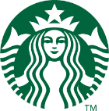
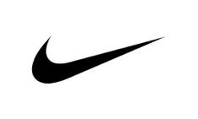
What is a Brand?
A brand is a name, term, design, symbol or any other feature that distinguishes one seller's good or service from those of other seller
A brand is promise, an experience
A brand builds loyalty
A brand evokes emotion
Notes:
When you see Starbucks, what does that mean to you? How does it make you feel? Starbucks vs Dunkin (or Canadian brand?)?
Do you have an iPhone or an Android? Would you switch? Why not? Why do you like your phone, what do you expect out of it?
Is Nike selling shoes, or lifestyle?
A brand evokes emotion

Slide 5
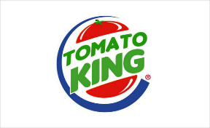
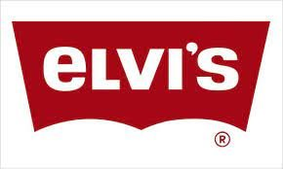
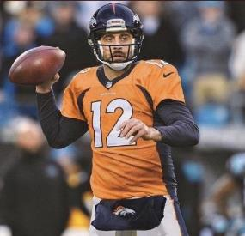
DNA/Vibe
What is it?
Should never waiver from what it is defined as
Think of some popular brands and what they mean to you
Should be pervasive throughout the property and all associates know it
Must be consistent and intentional, not piecemeal
What is your DNA to create and drive your brand identity?
What happens when it's wrong??
Notes:
Tell the story about Fire + Spice.
How we created it
5 words to describe it
Sizzle, southwest, energy, communal, fire

Slide 6
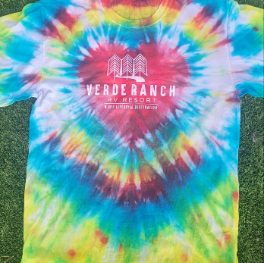
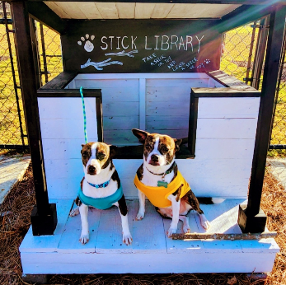
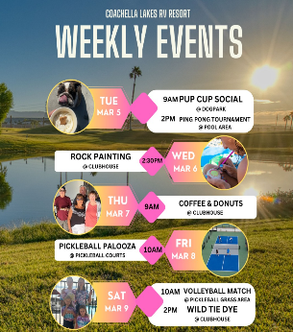
Who is responsible for branding?
Everyone!
What does branding apply to?
Everything!
Notes:
Is this just for the marketing dept?
If the brand or logo is created but then the property doesn't deliver then it falls flat. Must be consistent, and not created and forgotten.
Branding applies to everything

Slide 7
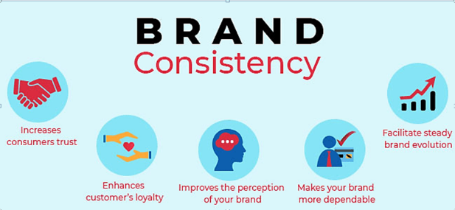
What should be consistent when using your brand?
EVERYTHING!
Split Second
Strategic
Fonts, Colors, proportions should all be consistent.
Why?
Everything
Communicates
Notes:
Logo consistency, color consistency, font consistency. MUST have integrity. I.e. wouldn’t put yellow in the KC Chiefs logo.
Do all of you associates have proper uniform? Is it the same?
You can go into any starbucks and know exactly white a white chocolate mocha is, what size, the flavor, same cup, etc... And they write your name on the cup. If they served it in a brown cardboard cup with no logo or name on it, you arent confident in what you are getting.
Call attention to my outfit – what am I saying when I wear this? Now Put on hat, glasses, take shirt off. Now what does this say?
What are your property, associates, logo, website communicating?

Slide 8
Where do you use your brand?
EVERYWHERE!
Physical
Uniforms
Signage
Buildings
Equipment
Digital
Website
Social media
Email campaigns
PMS
Print
Advertising
Signs
Maps
Packaging

Slide 9
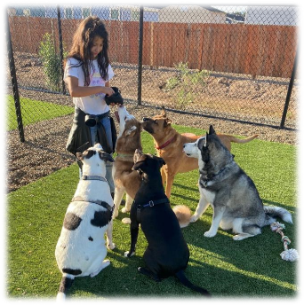
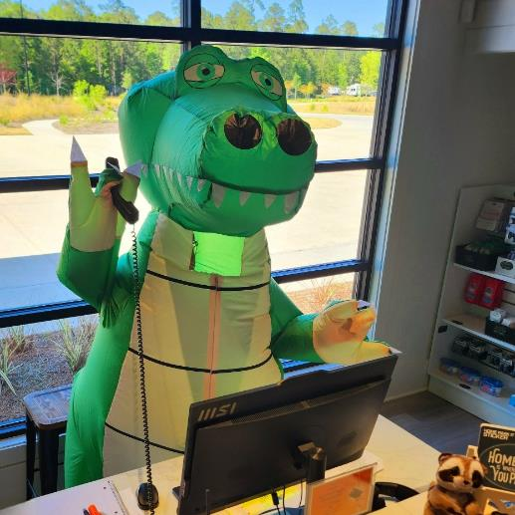
Storytelling and Activating
Book 5
By
Book 6
By

Slide 10
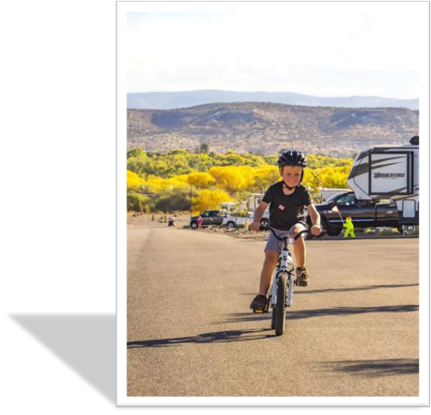
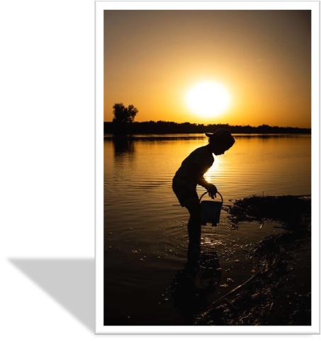
Book 5
By
Book 6
By

Slide 11
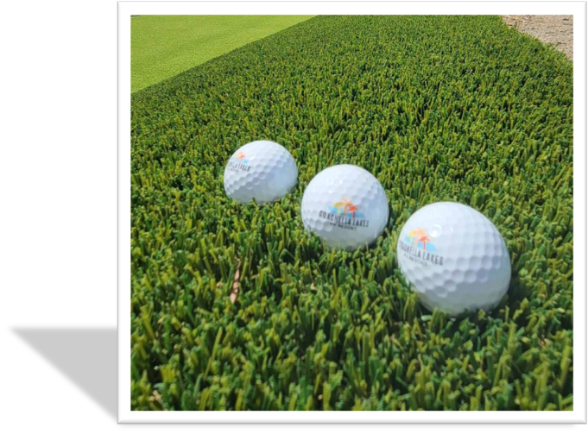
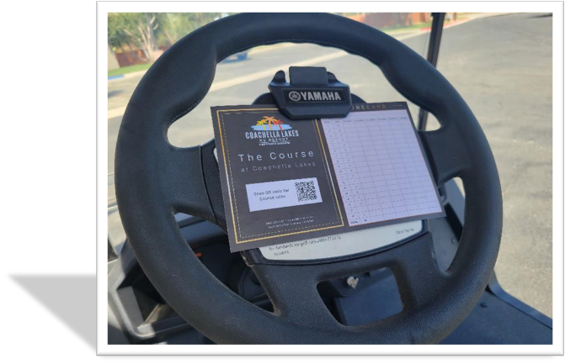
Book 5
By
Book 6
By

Slide 12
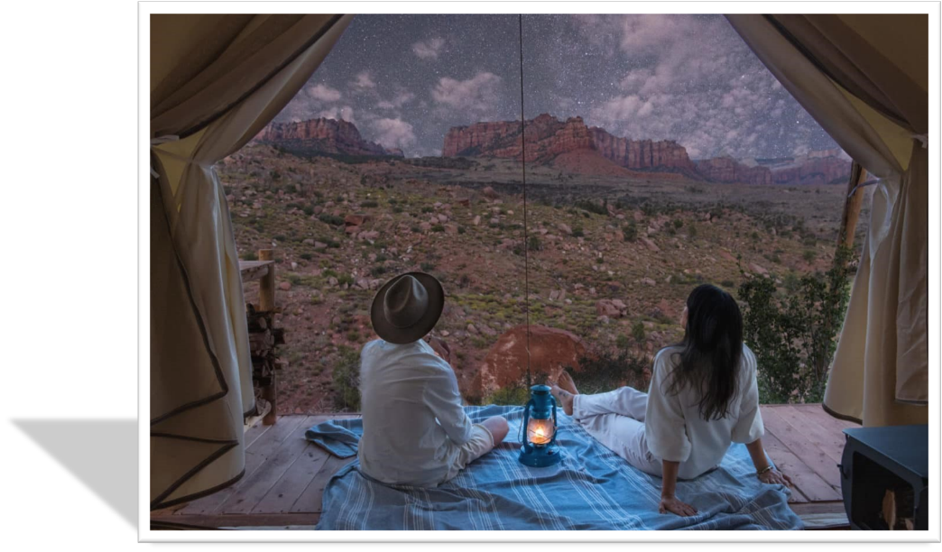

Slide 13
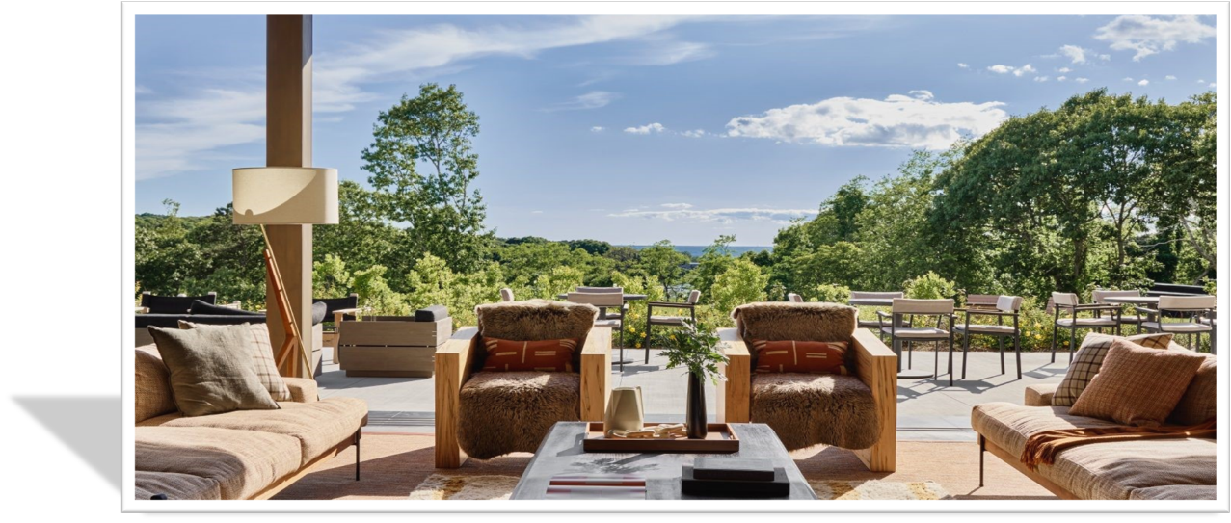

Slide 14
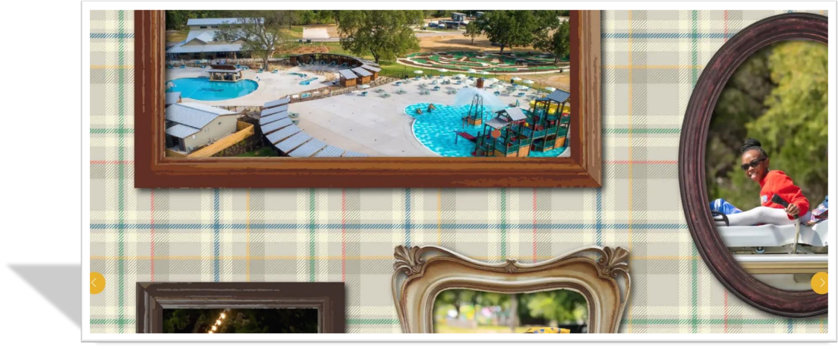

Slide 15
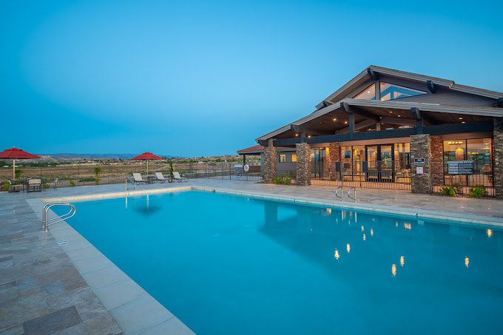
What’s Next?
Get ORGANIZED and PRIORITIZE
Look at your website
Collaborate on your vibe and DNA
Find a Marketing expert
Create a Marketing plan
Book 5
By
Book 6
By

Slide 16
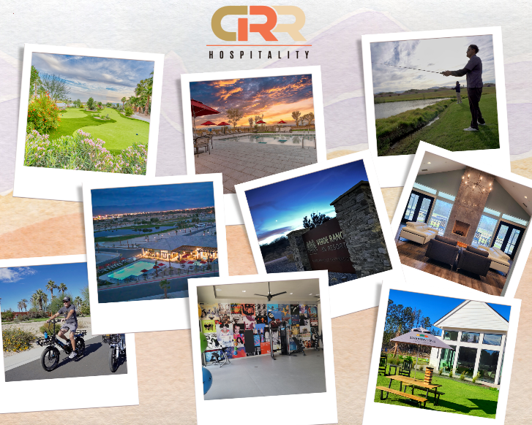
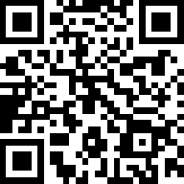
Questions? Connect with me: mharrison@crrhospitality.com Linked In www.CRRHospitality.com

Slide 17
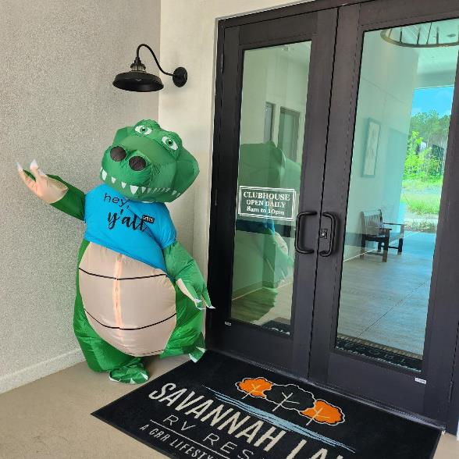
Thank you!

